Slide 1











Transformation of Line Integral of a Scalar Field
Transformation of Line Integral of a Scalar Field
Let’s consider line integration on arbitrary line $Ω$
$$\int_{Ω}{F(x)}dΩ$$
Assume $^{∃} 𝔗:r\left(r_{1},0,0\right)∈\tilde{Ω}↦x\left(x_{1},x_{2},x_{3}\right)∈Ω$.
Now we will see how a transformation affects integral by consider infinitesimal part of $\tilde{Ω}$ which is $∆\tilde{Ω}$ and its image $∆Ω$.
since $∆\tilde{Ω}$ is infinitesimal, $∆Ω$ also infinitesimal.
Thus
$$∆Ω≅{\left\|a\right\|}_{2}$$
Pre-image points of $a$ in $∆\tilde{Ω}$ are $\left(r_{1,0},0,0\right),\left(r_{1,0}+∆r_{1},0,0\right)$.
Then
$$a=\left[\begin{aligned}x_{1}\left(r_{1,0}+∆r_{1},0,0\right) \\ x_{2}\left(r_{1,0}+∆r_{1},0,0\right) \\ x_{3}\left(r_{1,0}+∆r_{1},0,0\right)\end{aligned}\right]−\left[\begin{aligned}x_{1}\left(r_{1,0},0,0\right) \\ x_{2}\left(r_{1,0},0,0\right) \\ x_{3}\left(r_{1,0},0,0\right)\end{aligned}\right]=\left[\begin{aligned}\frac{∂x_{1}}{∂r_{1}} \\ \frac{∂x_{2}}{∂r_{1}} \\ \frac{∂x_{3}}{∂r_{1}}\end{aligned}\right]∆r_{1}=\frac{∂𝕿}{∂r_{1}} ∆\tilde{Ω}$$
$$x_{3}$$
$$∆\tilde{Ω}$$
$$𝕿:ℝ→ℝ^{3}$$
$$∆Ω$$
$$\left(r_{1,0},0,0\right)$$
$$x=x(r)$$
$$a$$
$$r_{1}$$
$$x_{2}$$
$$x_{1}$$
Notes:
https://en.wikipedia.org/wiki/Integration_by_substitution#Substitution_for_multiple_variables

Slide 2

Transformation of Line Integral of a Scalar Field
Thus
$$∆Ω≅{\left\|a\right\|}_{ }=\left\|\frac{∂𝕿}{∂r_{1}}\right\| ∆\tilde{Ω}$$
We call$\left\|\frac{∂𝕿}{∂r_{1}}\right\|$ as a transformation scale function.
Using Reimann integral notion
$$\int_{Ω}{F(x)}dΩ=\lim{\sum_{i}{\sum_{j}{\sum_{k}{F\left(x_{i,j,k}\right)}}}∆Ω}=\lim{\sum_{i}{F\left(x_{1}\left(r_{i}\right),x_{2}\left(r_{i}\right),x_{3}\left(r_{i}\right)\right)}\left\|\frac{∂𝕿}{∂r_{1}}\right\| ∆\tilde{Ω}}=\int_{\tilde{Ω}}{\left(F∘𝕿\right)\left\|\frac{∂𝕿}{∂r_{1}}\right\|}d\tilde{Ω}$$
Where $x_{i,j,k}=x\left(x_{1,i},x_{2,j},x_{3,k}\right)$ and $r_{i}=r\left(r_{1,i},0,0\right)$

Slide 3



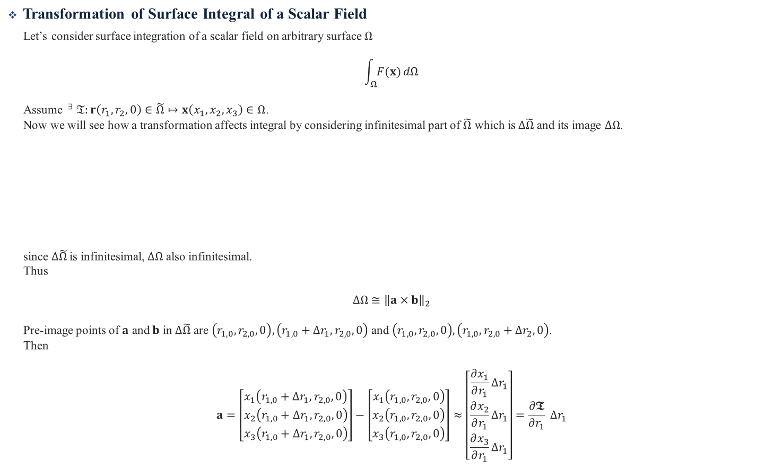








Transformation of Surface Integral of a Scalar Field
Transformation of Surface Integral of a Scalar Field
Let’s consider surface integration of a scalar field on arbitrary surface $Ω$
$$\int_{Ω}{F(x)}dΩ$$
Assume $^{∃} 𝔗:r\left(r_{1},r_{2},0\right)∈\tilde{Ω}↦x\left(x_{1},x_{2},x_{3}\right)∈Ω$.
Now we will see how a transformation affects integral by considering infinitesimal part of $\tilde{Ω}$ which is $∆\tilde{Ω}$ and its image $∆Ω$.
since $∆\tilde{Ω}$ is infinitesimal, $∆Ω$ also infinitesimal.
Thus
$$∆Ω≅{\left\|a×b\right\|}_{2}$$
Pre-image points of $a$ and $b$ in $∆\tilde{Ω}$ are $\left(r_{1,0},r_{2,0},0\right),\left(r_{1,0}+∆r_{1},r_{2,0},0\right)$ and $\left(r_{1,0},r_{2,0},0\right), \left(r_{1,0},r_{2,0}+∆r_{2},0\right)$.
Then
$$a=\left[\begin{aligned}x_{1}\left(r_{1,0}+∆r_{1},r_{2,0},0\right) \\ x_{2}\left(r_{1,0}+∆r_{1},r_{2,0},0\right) \\ x_{3}\left(r_{1,0}+∆r_{1},r_{2,0},0\right)\end{aligned}\right]−\left[\begin{aligned}x_{1}\left(r_{1,0},r_{2,0},0\right) \\ x_{2}\left(r_{1,0},r_{2,0},0\right) \\ x_{3}\left(r_{1,0},r_{2,0},0\right)\end{aligned}\right]≈\left[\begin{aligned}\frac{∂x_{1}}{∂r_{1}}∆r_{1} \\ \frac{∂x_{2}}{∂r_{1}}∆r_{1} \\ \frac{∂x_{3}}{∂r_{1}}∆r_{1}\end{aligned}\right]=\frac{∂𝕿}{∂r_{1}} ∆r_{1}$$
$$∆r_{1}$$
$$x_{3}$$
$$r_{2}$$
$$𝕿:ℝ^{2}→ℝ^{3}$$
$$∆Ω$$
$$∆r_{2}$$
$$∆\tilde{Ω}$$
$$b$$
$$\left(r_{1,0},r_{2,0}\right)$$
$$x=x(r)$$
$$a$$
$$x_{2}$$
$$r_{1}$$
$$x_{1}$$

Slide 4

Transformation of Surface Integral of a Scalar Field
$$b=\left[\begin{aligned}x_{1}\left(r_{1,0},r_{2,0}+∆r_{2},0\right) \\ x_{2}\left(r_{1,0},r_{2,0}+∆r_{2},0\right) \\ x_{3}\left(r_{1,0},r_{2,0}+∆r_{2},0\right)\end{aligned}\right]−\left[\begin{aligned}x_{1}\left(r_{1,0},r_{2,0},0\right) \\ x_{2}\left(r_{1,0},r_{2,0},0\right) \\ x_{3}\left(r_{1,0},r_{2,0},0\right)\end{aligned}\right]≈\left[\begin{aligned}\frac{∂x_{1}}{∂r_{2}}∆r_{2} \\ \frac{∂x_{2}}{∂r_{2}}∆r_{2} \\ \frac{∂x_{3}}{∂r_{2}}∆r_{2}\end{aligned}\right]=\frac{∂𝕿}{∂r_{2}} ∆r_{2}$$
$$\left\|a×b\right\|=\left\|\frac{∂𝕿}{∂r_{1}}×\frac{∂𝕿}{∂r_{2}}\right\|∆\tilde{Ω}$$
We call$\left\|\frac{∂𝕿}{∂r_{1}}×\frac{∂𝕿}{∂r_{2}}\right\|$ as a transformation scale function.
Using Reimann integral notion
$$\int_{Ω}{F(x)}dΩ=\lim{\sum_{i}{\sum_{j}{\sum_{k}{F\left(x_{i,j,k}\right)}}}∆Ω}=\lim{\sum_{i}{\sum_{j}{F\left(x_{1}\left(r_{i,j}\right),x_{2}\left(r_{i,j}\right),x_{3}\left(r_{i,j}\right)\right)}}\left\|\frac{∂𝕿}{∂r_{1}}×\frac{∂𝕿}{∂r_{2}}\right\|∆\tilde{Ω}}=\int_{\tilde{Ω}}{\left(F∘𝕿\right)\left\|\frac{∂𝕿}{∂r_{1}}×\frac{∂𝕿}{∂r_{2}}\right\|}d\tilde{Ω}$$
Where $x_{i,j,k}=x\left(x_{1,i},x_{2,j},x_{3,k}\right)$ and$r_{i,j}=r\left(r_{1,i},r_{2,j},0\right)$

Slide 5






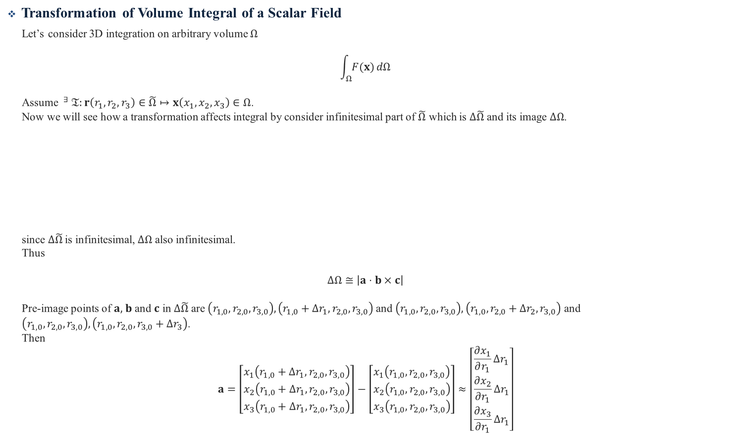







Transformation of Volume Integral of a Scalar Field
Transformation of Volume Integral of a Scalar Field
Let’s consider 3D integration on arbitrary volume $Ω$
$$\int_{Ω}{F(x)}dΩ$$
Assume $^{∃} 𝔗:r\left(r_{1},r_{2},r_{3}\right)∈\tilde{Ω}↦x\left(x_{1},x_{2},x_{3}\right)∈Ω$.
Now we will see how a transformation affects integral by consider infinitesimal part of $\tilde{Ω}$ which is $∆\tilde{Ω}$ and its image $∆Ω$.
since $∆\tilde{Ω}$ is infinitesimal, $∆Ω$ also infinitesimal.
Thus
$$∆Ω≅\left|a⋅b×c\right|$$
Pre-image points of $a,$ $b$ and $c$ in $∆\tilde{Ω}$ are $\left(r_{1,0},r_{2,0},r_{3,0}\right),\left(r_{1,0}+∆r_{1},r_{2,0},r_{3,0}\right)$ and $\left(r_{1,0},r_{2,0},r_{3,0}\right),\left(r_{1,0},r_{2,0}+∆r_{2},r_{3,0}\right)$ and $\left(r_{1,0},r_{2,0},r_{3,0}\right),\left(r_{1,0},r_{2,0},r_{3,0}+∆r_{3}\right)$.
Then
$$a=\left[\begin{aligned}x_{1}\left(r_{1,0}+∆r_{1},r_{2,0},r_{3,0}\right) \\ x_{2}\left(r_{1,0}+∆r_{1},r_{2,0},r_{3,0}\right) \\ x_{3}\left(r_{1,0}+∆r_{1},r_{2,0},r_{3,0}\right)\end{aligned}\right]−\left[\begin{aligned}x_{1}\left(r_{1,0},r_{2,0},r_{3,0}\right) \\ x_{2}\left(r_{1,0},r_{2,0},r_{3,0}\right) \\ x_{3}\left(r_{1,0},r_{2,0},r_{3,0}\right)\end{aligned}\right]≈\left[\begin{aligned}\frac{∂x_{1}}{∂r_{1}}∆r_{1} \\ \frac{∂x_{2}}{∂r_{1}}∆r_{1} \\ \frac{∂x_{3}}{∂r_{1}}∆r_{1}\end{aligned}\right]$$
$$r_{3}$$
$$x_{3}$$
$$∆r_{3}$$
$$𝔗_{i}$$
$$c$$
$$∆Ω$$
$$\left(r_{1,0},r_{2,0},r_{3,0}\right)$$
$$∆\tilde{Ω}$$
$$r_{2}$$
$$x=x(r)$$
$$a$$
$$b$$
$$x_{2}$$
$$∆r_{2}$$
$$∆r_{1}$$
$$r_{1}$$
$$x_{1}$$

Slide 6

Transformation of Volume Integral of a Scalar Field
$$b=\left[\begin{aligned}x_{1}\left(r_{1,0},r_{2,0}+∆r_{2},r_{3,0}\right) \\ x_{2}\left(r_{1,0},r_{2,0}+∆r_{2},r_{3,0}\right) \\ x_{3}\left(r_{1,0},r_{2,0}+∆r_{2},r_{3,0}\right)\end{aligned}\right]−\left[\begin{aligned}x_{1}\left(r_{1,0},r_{2,0},r_{3,0}\right) \\ x_{2}\left(r_{1,0},r_{2,0},r_{3,0}\right) \\ x_{3}\left(r_{1,0},r_{2,0},r_{3,0}\right)\end{aligned}\right]≈\left[\begin{aligned}\frac{∂x_{1}}{∂r_{2}}∆r_{2} \\ \frac{∂x_{2}}{∂r_{2}}∆r_{2} \\ \frac{∂x_{3}}{∂r_{2}}∆r_{2}\end{aligned}\right]$$
$$c=\left[\begin{aligned}x_{1}\left(r_{1,0},r_{2,0},r_{3,0}+∆r_{3}\right) \\ x_{2}\left(r_{1,0},r_{2,0},r_{3,0}+∆r_{3}\right) \\ x_{3}\left(r_{1,0},r_{2,0},r_{3,0}+∆r_{3}\right)\end{aligned}\right]−\left[\begin{aligned}x_{1}\left(r_{1,0},r_{2,0},r_{3,0}\right) \\ x_{2}\left(r_{1,0},r_{2,0},r_{3,0}\right) \\ x_{3}\left(r_{1,0},r_{2,0},r_{3,0}\right)\end{aligned}\right]≈\left[\begin{aligned}\frac{∂x_{1}}{∂r_{3}}∆r_{3} \\ \frac{∂x_{2}}{∂r_{3}}∆r_{3} \\ \frac{∂x_{3}}{∂r_{3}}∆r_{3}\end{aligned}\right]$$
$$a⋅b×c=\left[a b c \right]∆\tilde{Ω}=\left[\begin{matrix}\frac{∂x_{1}}{ ∂r_{1}} & \frac{∂x_{2}}{ ∂r_{1}} & \frac{∂x_{3}}{ ∂r_{1}} \\ \frac{∂x_{1}}{ ∂r_{2}} & \frac{∂x_{2}}{ ∂r_{2}} & \frac{∂x_{3}}{ ∂r_{2}} \\ \frac{∂x_{1}}{ ∂r_{3}} & \frac{∂x_{2}}{ ∂r_{3}} & \frac{∂x_{3}}{ ∂r_{3}}\end{matrix}\right]∆\tilde{Ω}$$
At this time, Jacobian matrix of transformation is
$$J=\left[\begin{matrix}\frac{∂x_{1}}{ ∂r_{1}} & \frac{∂x_{1}}{ ∂r_{2}} & \frac{∂x_{1}}{ ∂r_{3}} \\ \frac{∂x_{2}}{ ∂r_{1}} & \frac{∂x_{2}}{ ∂r_{2}} & \frac{∂x_{2}}{ ∂r_{3}} \\ \frac{∂x_{3}}{ ∂r_{1}} & \frac{∂x_{3}}{ ∂r_{2}} & \frac{∂x_{3}}{ ∂r_{3}}\end{matrix}\right]$$

Slide 7

Transformation of Volume Integral of a Scalar Field
Thus
$$a⋅b×c=J^{T}$$
$$⇒a⋅b×c=\left|det\left(\left[a b c\right]\right)\right|=\left|det\left(J^{T}\right)\right|=\left|det\left(J\right)\right|$$
Using Reimann integral notion
$$\int_{Ω}{F(x)}dΩ=\lim{\sum_{i}{\sum_{j}{\sum_{k}{F\left(x_{i,j,k}\right)}}}∆Ω}=\lim{\sum_{i}{\sum_{j}{\sum_{k}{F\left(x_{1}\left(r_{i,j,k}\right),x_{2}\left(r_{i,j,k}\right),x_{3}\left(r_{i,j,k}\right)\right)}}}\left|\det\left(J\right)\right|∆\tilde{Ω}}=\int_{\tilde{Ω}}{\left(F∘𝕿\right)|det\left(J\right)|}d\tilde{Ω}$$
Where $x_{i,j,k}=x\left(x_{1,i},x_{2,j},x_{3,k}\right)$ and $r_{i,j,k}=r\left(r_{1,i},r_{2,j},r_{3,k}\right)$

Slide 8











Transformation of Line Integral of a Vector Field
Line Integral Across a Curve
Let’s consider line integral across a curve on arbitrary line $Ω$
$$\int_{Ω}{F(x)⋅n}dΩ$$
Assume $^{∃} 𝔗:r\left(r_{1},0\right)∈\tilde{Ω}↦x\left(x_{1},x_{2}\right)∈Ω$.
Here normal vector $n$ can be determined alone when transformation is less then 2D.
Now we will see how a transformation affects line integral by consider infinitesimal part of $\tilde{Ω}$ which is $∆\tilde{Ω}$ and its image $∆Ω$.
since $∆\tilde{Ω}$ is infinitesimal, $∆Ω$ also infinitesimal.
Thus
$$∆Ω≅\left\|a\right\|$$
and
$$a⋅n=0$$
Pre-image points of $a$ in $∆\tilde{Ω}$ are $\left(r_{1,0},0\right),\left(r_{1,0}+∆r_{1},0\right)$.
$$r_{2}$$
$$x_{2}$$
$$𝔗_{i}$$
$$∆Ω$$
$$\tilde{n}=(0,1)$$
$$x=x(r)$$
$$n$$
$$∆\tilde{Ω}$$
$$a$$
$$\left(r_{1,0},0\right)$$
$$∆r_{1}$$
$$r_{1}$$
$$x_{1}$$

Slide 9

Transformation of Line Integral of a Vector Field
Then
$$a=\left[\begin{aligned}x_{1}\left(r_{1,0}+∆r_{1},0,0\right) \\ x_{2}\left(r_{1,0}+∆r_{1},0,0\right)\end{aligned}\right]−\left[\begin{aligned}x_{1}\left(r_{1,0},0,0\right) \\ x_{2}\left(r_{1,0},0,0\right)\end{aligned}\right]≈\left[\begin{aligned}\frac{∂x_{1}}{∂r_{1}} \\ \frac{∂x_{2}}{∂r_{1}}\end{aligned}\right]∆r_{1}=\frac{∂𝕿}{∂r_{1}} ∆\tilde{Ω}$$
Thus one of choice of $n$ is
$$n^{′}=\left[\begin{aligned}−\frac{∂x_{2}}{∂r_{1}} \\ \frac{∂x_{1}}{∂r_{1}}\end{aligned}\right]∆\tilde{Ω}⇒n=\frac{n^{′}}{\left\|n^{′}\right\|}$$
Using Reimann integral notion
$$\int_{Ω}{F(x)⋅n}dΩ=\lim{\sum_{i}{\sum_{j}{F\left(x_{i,j}\right)⋅n∆Ω}}}=\lim{\sum_{i}{F\left(x_{1}\left(r_{i}\right),x_{2}\left(r_{i}\right)\right)}⋅\frac{n^{′}}{\left\|n^{′}\right\|}\left\|\frac{∂𝕿}{∂r_{1}}\right\|∆\tilde{Ω}}=\int_{\tilde{Ω}}{\left(F∘𝕿\right)⋅n′}d\tilde{Ω}$$
Where $x_{i,j}=x\left(x_{1,i},x_{2,j}\right)$ and $r_{i}=r\left(r_{1,i},0\right)$

Slide 10










Transformation of Surface Integral of a Vector Field
Transformation of Surface Integral of a Vector Field
Let’s consider surface integration of a vector field on arbitrary surface $Ω$
$$\int_{Ω}{F(x)⋅n}dΩ$$
Assume $^{∃} 𝔗:r\left(r_{1},r_{2},0\right)∈\tilde{Ω}↦x\left(x_{1},x_{2},x_{3}\right)∈Ω$.
Now we will see how a transformation affects surface integral by consider infinitesimal part of $\tilde{Ω}$ which is $∆\tilde{Ω}$ and its image $∆Ω$.
since $∆\tilde{Ω}$ is infinitesimal, $∆Ω$ also infinitesimal.
Thus
$$∆Ω≅\left\|a×b\right\|$$
and
$$n=a×b$$
$$\hat{n}=\frac{n}{\left\|n\right\|}$$
$$r_{3}$$
$$x_{3}$$
$$\tilde{n}=(0,0,1)$$
$$∆Ω$$
$$𝔗_{i}$$
$$b$$
$$\left(r_{1,0},r_{2,0},0 \right)$$
$$∆\tilde{Ω}$$
$$r_{2}$$
$$x=x(r)$$
$$a$$
$$x_{2}$$
$$∆r_{1}$$
$$n$$
$$∆r_{2}$$
$$r_{1}$$
$$x_{1}$$

Slide 11

Transformation of Surface Integral of a Vector Field
Pre-image points of $a$ and $b$ in $∆\tilde{Ω}$ are $\left(r_{1,0},r_{2,0},0\right),\left(r_{1,0}+∆r_{1},r_{2,0},0\right)$ and $\left(r_{1,0},r_{2,0},0\right), \left(r_{1,0},r_{2,0}+∆r_{2},0\right)$.
Then
$$a=\left[\begin{aligned}x_{1}\left(r_{1,0}+∆r_{1},r_{2,0},0\right) \\ x_{2}\left(r_{1,0}+∆r_{1},r_{2,0},0\right) \\ x_{3}\left(r_{1,0}+∆r_{1},r_{2,0},0\right)\end{aligned}\right]−\left[\begin{aligned}x_{1}\left(r_{1,0},r_{2,0},0\right) \\ x_{2}\left(r_{1,0},r_{2,0},0\right) \\ x_{3}\left(r_{1,0},r_{2,0},0\right)\end{aligned}\right]≈\left[\begin{aligned}\frac{∂x_{1}}{∂r_{1}}∆r_{1} \\ \frac{∂x_{2}}{∂r_{1}}∆r_{1} \\ \frac{∂x_{3}}{∂r_{1}}∆r_{1}\end{aligned}\right]=\frac{∂𝕿}{∂r_{1}}∆r_{1}$$
$$b=\left[\begin{aligned}x_{1}\left(r_{1,0},r_{2,0}+∆r_{2},0\right) \\ x_{2}\left(r_{1,0},r_{2,0}+∆r_{2},0\right) \\ x_{3}\left(r_{1,0},r_{2,0}+∆r_{2},0\right)\end{aligned}\right]−\left[\begin{aligned}x_{1}\left(r_{1,0},r_{2,0},0\right) \\ x_{2}\left(r_{1,0},r_{2,0},0\right) \\ x_{3}\left(r_{1,0},r_{2,0},0\right)\end{aligned}\right]≈\left[\begin{aligned}\frac{∂x_{1}}{∂r_{2}}∆r_{2} \\ \frac{∂x_{2}}{∂r_{2}}∆r_{2} \\ \frac{∂x_{3}}{∂r_{2}}∆r_{2}\end{aligned}\right]=\frac{∂𝕿}{∂r_{2}}∆r_{2}$$
$$n=a×b =\frac{∂𝕿}{∂r_{1}}\frac{∂𝕿}{∂r_{2}}∆\tilde{Ω}$$

Slide 12

Transformation of Surface Integral of a Vector Field
Thus
$$\hat{n}=\frac{a×b}{\left\|a×b\right\|}=\frac{Cof\left(J\right)⋅\tilde{n}}{{\left\|Cof\left(J\right)⋅\tilde{n}\right\|}_{F}}$$
We call $Cof\left(J\right)$ as transformation normal matrix.
Here
$$∆Ω={\left\|Cof\left(J\right)\right\|}_{F} ∆\tilde{Ω}$$
Using Reimann integral notion
$$\int_{Ω}{F(x)⋅n}dΩ=\lim{\sum_{i}{\sum_{j}{\sum_{k}{F\left(x_{i,j,k}\right)⋅n∆Ω}}}}=\lim{\sum_{i}{\sum_{J}{F\left(x_{1}\left(r_{i,j}\right),x_{2}\left(r_{i,j}\right),x_{3}(r_{i,j})\right)Cof\left(J\right)⋅\tilde{n}∆\tilde{Ω}}}}=\int_{\tilde{Ω}}{\left(F∘𝕿\right)⋅Cof\left(J\right)⋅\tilde{n}}d\tilde{Ω}$$
Where $x_{i,j,k}=x\left(x_{1,i},x_{2,j},x_{3,k}\right)$ and $r_{i,j}=r\left(r_{1,i},r_{2,j},0\right)$

Slide 13
















Appendix
Transformation of Normal Vector
We consider surface normal vector $\tilde{n}$ in reference element $\tilde{Ω}$ which is tangent to the surface at $r$.
Then we assume there is a invertible transformation $𝔗_{i}$ which mapping from reference element $\tilde{Ω}$ to physical element $Ω$.
$$𝔗_{i}:r=\left(u,v\right)∈\tilde{Ω}↦x=\left(x,y\right)∈Ω_{ }$$
$$x=x(r)$$
Then we want to know relationship between reference surface normal vector $\tilde{n}$ and $n$ which is tangent to the surface at $x$.
Unfortunately, it can’t be obtained by simple transformation
$$𝔗_{i}\left(\tilde{n}\right)≠n$$
At first, we use the fact that $n$ is tangent to the surface at $x$.
we define infinitesimally small vector $∆r$ in $Ω_{i}$
$$∆r=r_{n}−r$$
$$v$$
$$\tilde{n}$$
$$y$$
$$∆r$$
$$Ω_{ }$$
$$n$$
$$r$$
$$r_{n}$$
$$𝔗_{i}$$
$$x$$
$$∆x$$
$$\tilde{Ω}$$
$$x_{n}$$
$$u$$
$$x$$

Slide 14

Appendix
Since we assume infinitesimally small $∆r$ we can safely say
$$∆r⋅\tilde{n}=0$$
and
$$∆x=𝔗\left(r\right)−𝔗(r_{n})≅J_{𝔗}(r)∆r$$
From the fact that $n$ and $∆x$ must be orthogonal
$$∆x⋅n=\left(J\left(r\right)∆r\right)⋅n={\left(∆r\right)}^{T}J{\left(r\right)}^{T}n=0$$
If $J(r)$ is invertible matrix,
$$n=\frac{{\left(J{\left(r\right)}^{T}\right)}^{−1}\tilde{n}}{\left\|{\left(J{\left(r\right)}^{T}\right)}^{−1}\tilde{n}\right\|}$$

